Slide 1
Digital Assistant for Students
Short questionaire
Anton, Lorenzo, Luca, Marc

Slide 2
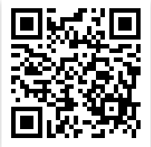
https://bit.ly/35GZTAu

